Slide 1
Magnet Current Leads
Tom Peterson, SLAC
January, 2017
USPAS

Slide 2
Current lead introduction
Problem: carry electric current, often 100’s or 1000’s of amps, to superconductor at LHe temperature with minimal heat conduction down the current lead
  In theory a nice one-dimensional optimization
  Many papers describing mathematical solutions and analyses. I have collected a few favorites over the years which I’ll cite here.
  Date back to the 1960’s with the development of SC magnets, for example for bubble chambers
Sometimes referred to as “counterflow current leads” since often cooled with helium vapor flowing up the lead
Also may be called “power leads” since carrying electrical power into the superconductor

Slide 3
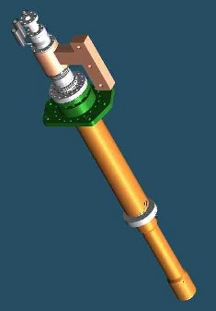
Current leads
Well-developed technology
Much information in the cryogenics literature
HTS materials work very well in current leads up to 80 K

Slide 4
From John Pfotenhauer,
University of Wisconsin,
Madison

Slide 5
Current lead design issues, material and dimensions
Material selection
  One seeks a balance of heat conducted down the lead (it must be an electrical conductor, hence thermal conduction is significant) with heat generated within the lead
  The optimum is generally a low RRR copper
  Conductor properties vary over the large temperature range up the lead
Optimize dimensions (length, cross section)
  Many authors present optimized length x current / area (LI/A) for various material parameters and cooling temperatures

Slide 6
Current lead design issues, thermal and fluid dynamic
Heat transfer for convective cooling
  Huge range of fluid temperatures up the lead, hence large changes in fluid density, velocity, convection coefficients
Cooling conditions – saturated vapor
  Many papers and designs consider current leads for operation in a dewar
  “Self-cooling” in generating saturated vapor from boiling liquid based on heat transfer to bottom of lead
  Very low pressure drop up the lead is required
Cooling conditions – pressurized helium (subcooled, supercritical, or gas at the lead base)
  Flow control is independent of heat input
  Heat may be convected into the flow stream passing the lead

Slide 7
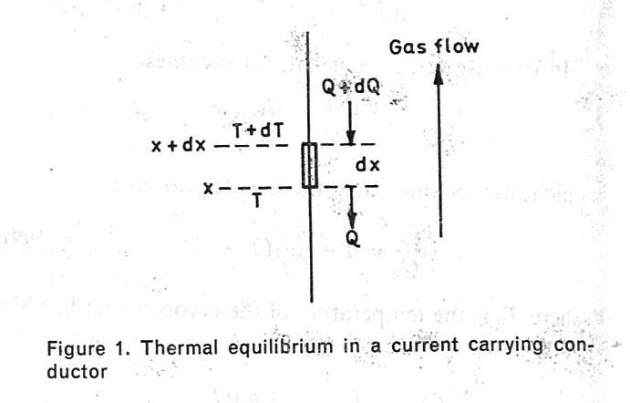
Current lead mathematical model
From Lock (ref 1)

Slide 8
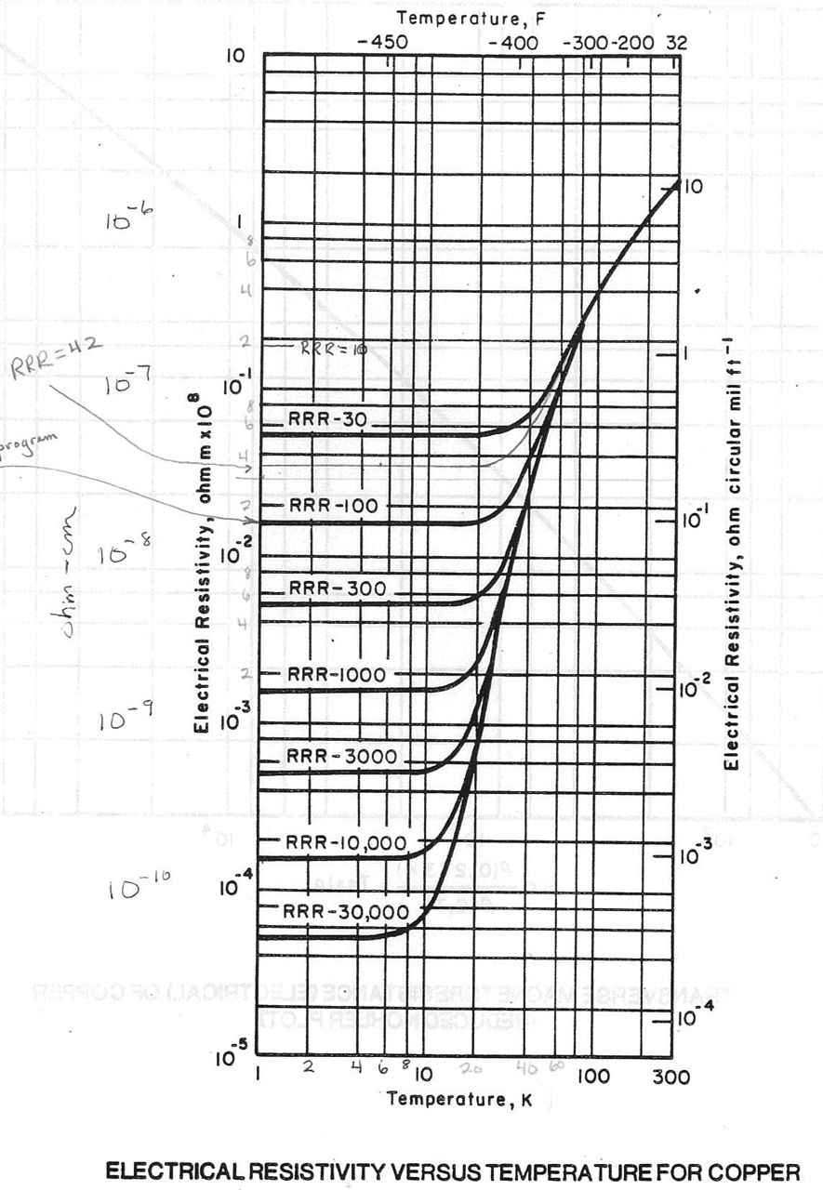
Resistivity of copper vs temperature

Slide 9
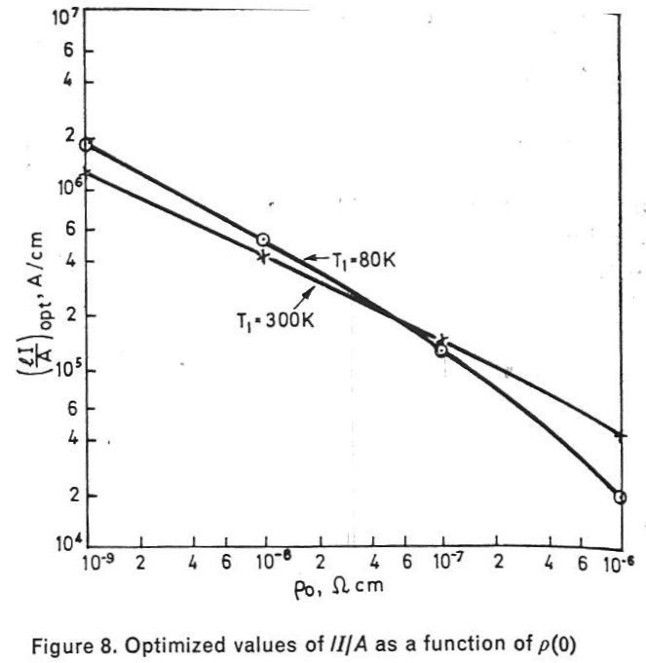
Optimum LI/A from Lock
(ref 1)
LI/A = 2.3 x 10⁵ A/cm

Slide 10
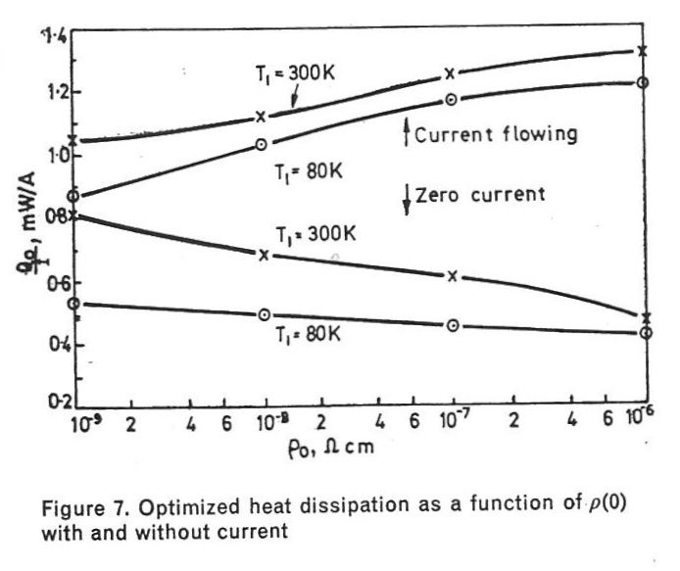
Optimum residual resistivity, from Lock
(ref 1)

Slide 11
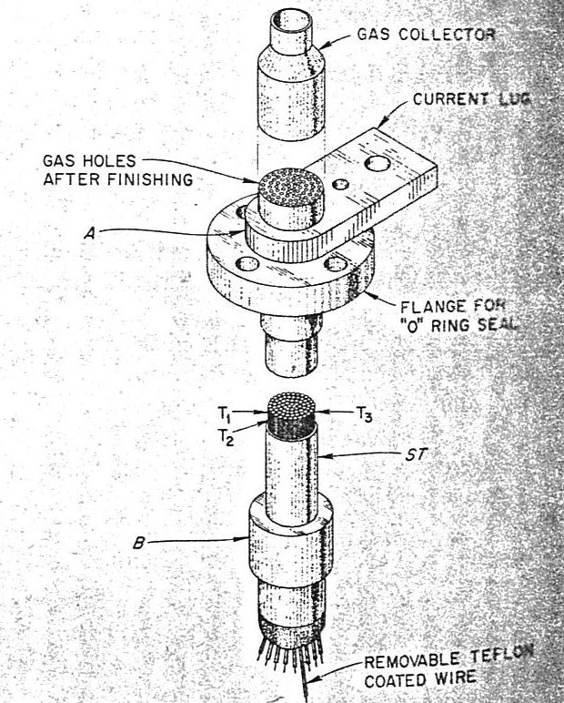
American Magnetics, Inc. (AMI) current lead design by K. R. Efferson (ref 2)

Slide 12
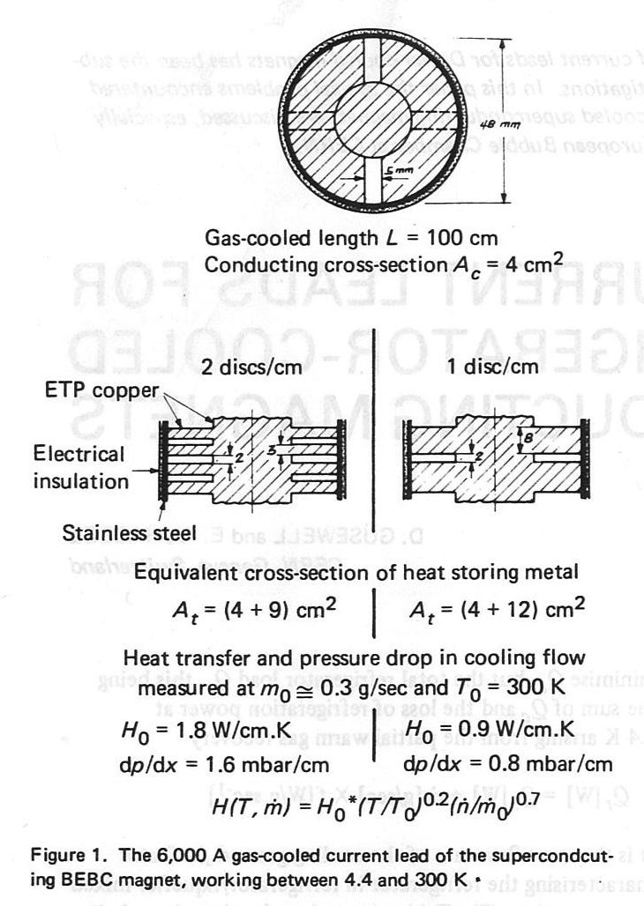
Big European Bubble Chamber (BEBC, CERN) current lead design for heat exchange with the helium gas
(ref 3)

Slide 13
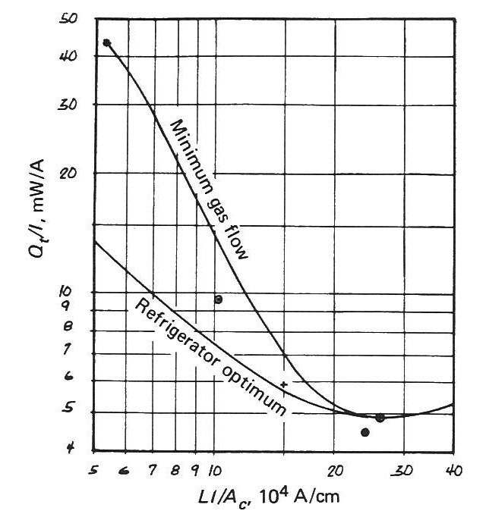
CERN BEBC current lead optimum considering refrigeration as well as current lead flow (ref 3)
LI/A = 2.3 x 10⁵ A/cm

Slide 14
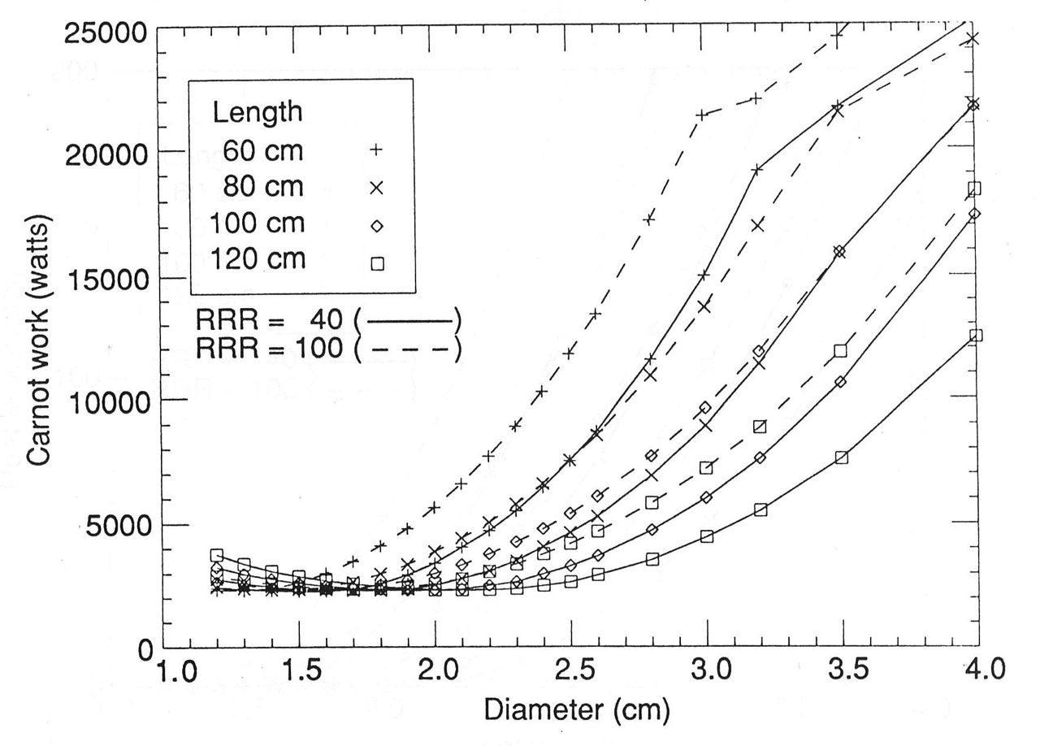
Parameter study for SSC lead
(ref 4)
LI/A = 2.1 x 10⁵ A/cm

Slide 15
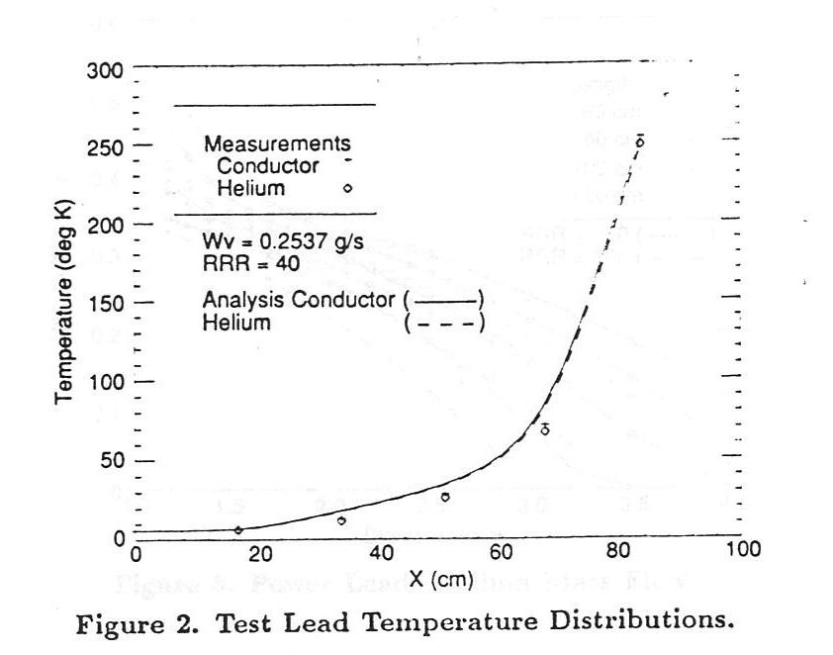
Typical temperature distribution
SSC study
(ref 4)

Slide 16
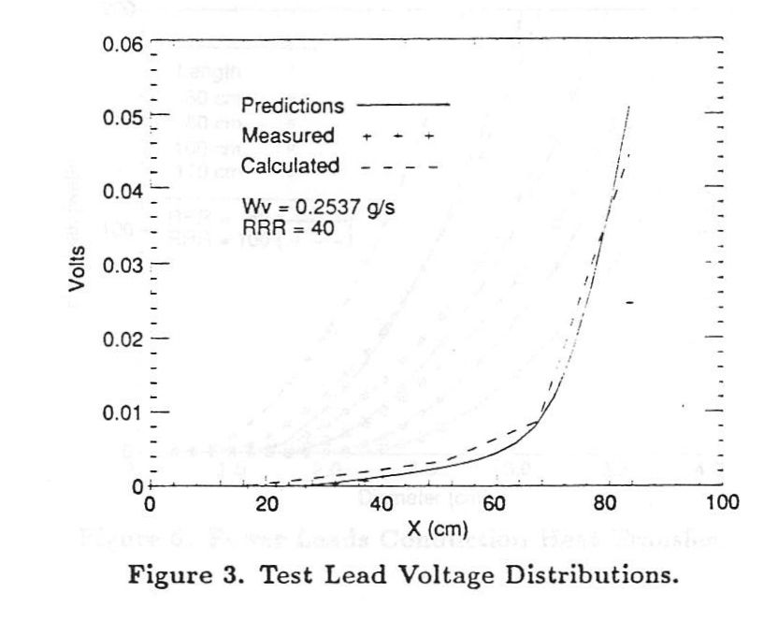
Voltages in the lead
(ref 4)

Slide 17
Lead voltage
The overall voltage in a current lead provides an integrated resistance measurement, so indirectly an integrated temperature measurement
Lead voltages for forced-flow cooled current leads at Fermilab were all typically in the 40 to 100 mV range, above 100 mV indicating a cooling problem

Slide 18
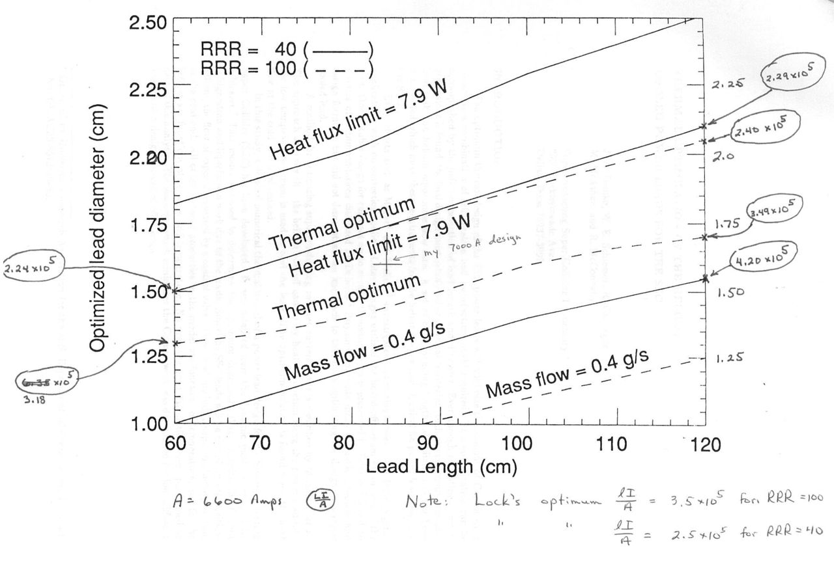
A page from the SSC paper (ref 4) with my notes

Slide 19
Average system-wide current lead flows for the Tevatron at 4 kA (data taken by Tom P., 6 May 1987)
Notes: feedcan and power spool had very different configurations,
with better convective cooling at the lead base in the feedcan.
Average is about 0.4 grams/sec for 4 kA.
0.1 grams/sec helium cooling per kA was typical also at MTF.

Slide 20
Conductively cooled leads
No counter-current gas flow
OK for lower current (<100 A)
Heat load penalty offset by simplification
Subatmospheric 2 Kelvin space cannot drive lead flow, need another cooling source or conductive cooling
CERN corrector leads, XFEL magnet leads, others for magnets in 2 K SRF systems

Slide 21
Conductively cooled lead package

Slide 22
Conductively cooled lead package

Slide 23
High Temperature Superconductors
Fermilab tested and operated some HTS current leads at 4.5 kA to 6 kA for the Tevatron, and a few of them ran for many years in the Tevatron
  LN2 cooled copper section
  Small helium vapor flow up HTS section
  Very stable and reliable
  Design issues involved solder joints to various conductors (LTS – HTS – copper) and isolation of N2 from helium channels
  See references 5 and 6 for more information

Slide 24
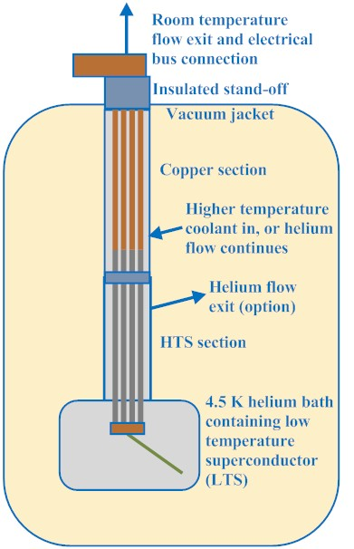
HTS lead arrangement

Slide 25
High Temperature Superconductors
CERN’s LHC current leads for currents above a few 100 amps are HTS leads, helium gas cooled from nominally 20 K gas
  See reference 7 for more information
The Fermilab/Berkeley collaboration incorporated 7.5 kA HTS current leads into the DFBX feed boxes for the LHC inner triplet magnets, also helium cooled
  http://tdserver1.fnal.gov/peterson/tom/DFBXimages/HTSleads/index.html

Slide 26
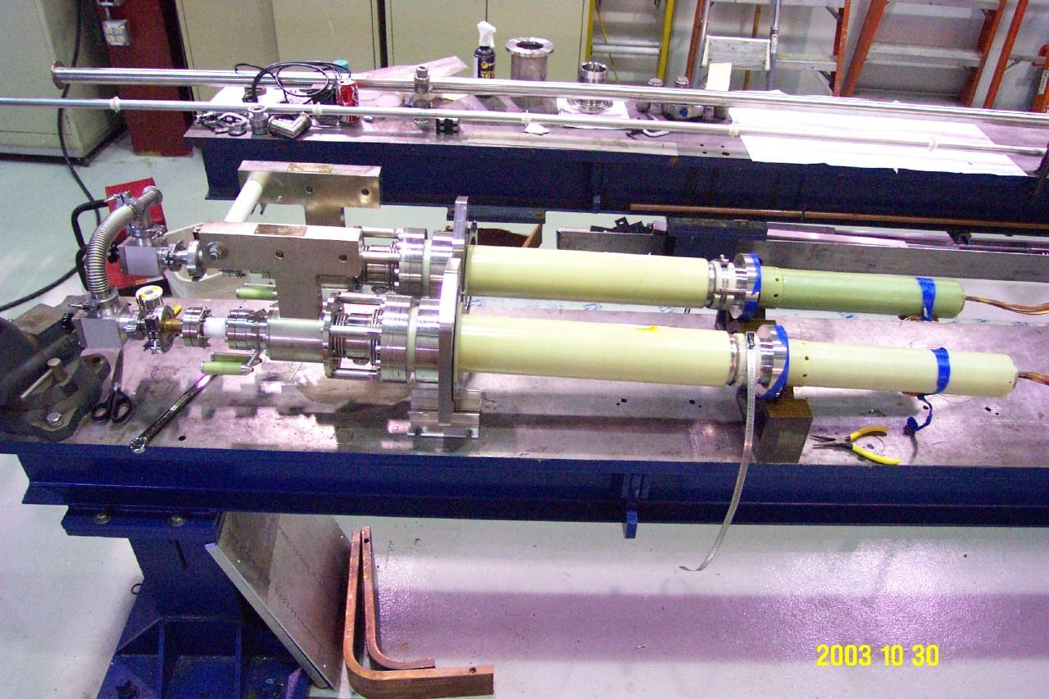
7.5 kA HTS leads for DFBX

Slide 27
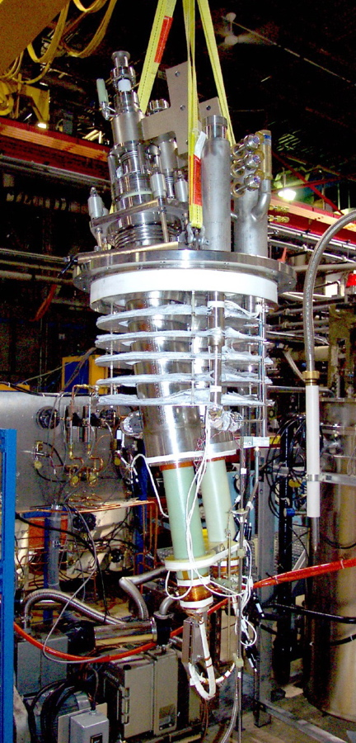
Current lead installation
Most problems today arise with current lead integration into the supply box
  Temperature at top plate
    Leakage of cold seals
  Vacuum or “chimney” enclosure
    Heat transfer around or into lead
  Temperature at joint to superconductor
    Quench avoidance forces higher than optimal current lead flow
DFBX HTS leads

Slide 28
Current leads conclusion
Looks like a nice, one-dimensional problem
Much good analysis in the literature
The difficulties arise in implementation
  Integration with the cryostat
  Superconductor-to-copper splice joints or HTS to LTS joints
  Flow balance and control: heat load at cold end versus frost at warm end, heat exchange not as good as anticipated
  Hi pot problems, electrical stand-off issues
My advice is to search the literature and access experience regarding leads which you need, but also assume they will require some engineering attention

Slide 29
Current lead references
J.M. Lock, “Optimization of Current Leads into a Cryostat,” Cryogenics, Dec 1969.
K.R. Efferson, “Helium Vapor Cooled Current Leads,” The Review of Scientific Instruments, Vol 38, No. 12, Dec 1967.
D. Guesewell and E. –U. Haebel, “Current Leads for Refrigerator-Cooled Large Superconducting Magnets,” 3rd International Conference on High-energy Physics and Nuclear Structure, New York, NY, USA, 8 - 12 Sep 1969.
J.A. Demko, et al, “Thermal Optimization of the Helium Cooled Power Leads for the SSC,” Proceedings of the Supercollider 4 Conference, New Orleans, 1992.
G. Citver, S. Feher, T.J. Peterson, C.D. Sylvester, “ Thermal Tests of 6 kA HTS Current Leads for the Tevatron,” Advances in Cryogenic Engineering, Vol. 45B, pg. 1549.

Slide 30
Current lead references
J. Brandt, S. Feher, T.J. Peterson, W.M. Soyars, “HTS Leads in the Tevatron,” Advances in Cryogenic Engineering, Vol. 47A, pg. 567.
A. Ballarino, S. Mathot, and D. Milani, “13000 A HTS Current Leads for the LHC Accelerator: from Conceptual Design to Prototype Validation,” LHC Project Report 696, Presented at the 6th European Conference on Applied Superconductivity (EUCAS 2003) 14-18 September 2003.
T.P. Andersen, V. Benda, B. Vullierme, “600 A Current Leads with Dry and Compact Warm Terminals,” LHC Project Report 605
A. Ballarino, “Conduction-Cooled 60 A Resistive Current Leads for LHC Dipole Correctors,” LHC Project Report 691

